Slide 1
Sixteenth –Century Painting in Northern Europe
Chapter 16

Slide 2
Cultural/Historical Developments
Martin Luther, 95 Theses, beginning of Reformation (1517)
Martin Luther, excommunicated (1521)
Henry VIII, founder of the Anglican Church (1534)
Council of Trent- (1545-1563) Counter-Reformation

Slide 3
Vocabulary
Alchemy
Triptych
Engraving
Intaglio
Edition
Woodcut
Etching

Slide 4
Artists
Hieronymus Bosch
Pieter Bruegel the Elder
Albrecht Durer
Matthias Gruewald
Lucas Cranach the Elder
Hans Holbein the Younger

Slide 5
Notes:
Start at 31 muiutes Intro to Notrhern Renaissance.

Slide 6
Hieronymous Bosch (1450-1516)(Dutch)
Moralistic paintings suggesting inventive torments as punishment for sinners
Grotesque fantasy images- such as hyrid monsters,half-human, half animal
Strange ,unsettling landscapes
Corrupt mankind-seduced by evil,should suffer calamitous consequences

Slide 7
Hieronymous Bosch
Garden of Earthly Delights
1510-1515
Triptych
Oil on wood
7ft. 2 in x 6ft. 4 in

Slide 8
Notes:
10 minute segments about 50 minutes

Slide 9
Hieronymous Bosch
Garden of Earthly Delights
1510-1515
Triptych
Oil on wood
7ft. 2 in x 6ft. 4 in

Slide 10
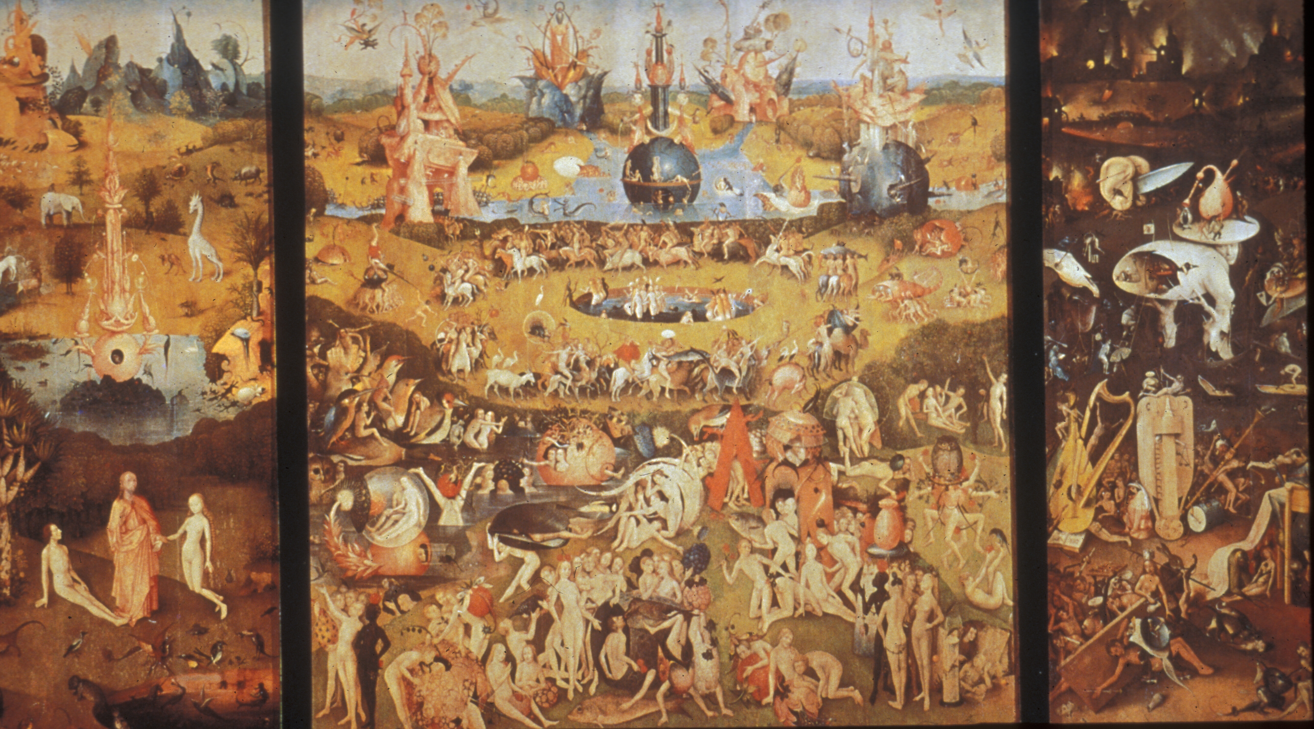

Slide 11
Pieter Bruegel the Elder (1525- 1569)(Dutch)
Influenced by Bosch’s pessimism and satiric approach
Peasant life his subject
Elevates “Genre” painting-(scenes of everyday life) to the stature of high art
Illustrated proverbs
Used atmospheric perspective

Slide 12
Notes:
The world of Pieter Bruegel

Slide 13
Pieter Bruegel the Elder
Landscape with theFall of Icarus
1554- 1555
Oil on panel (transferred to canvas)
2ft. 5 in. x 3ft. 8 1/18 in
Musees Royaux de Beaux-Arts de Belgique
Brussels

Slide 14
Notes:
Fall of Icarus. 5 minute

Slide 15
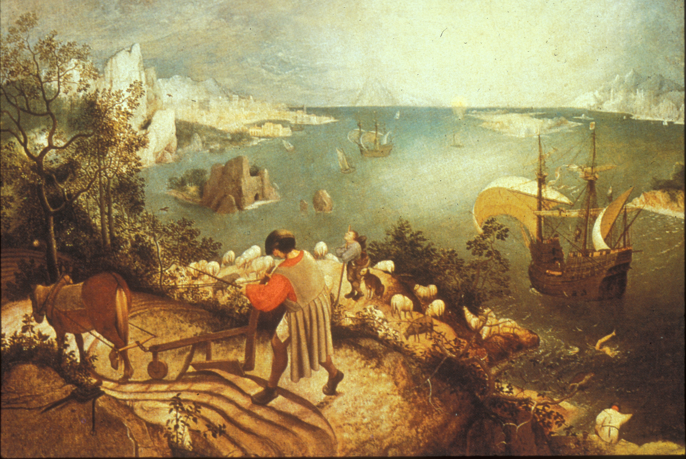

Slide 16
Pieter Bruegel the Elder
Netherlandish Proverbs
1559
Panel
3ft. 10in. X 5 ft 4 ½ inches
Staatliche Museen
Berlin

Slide 17
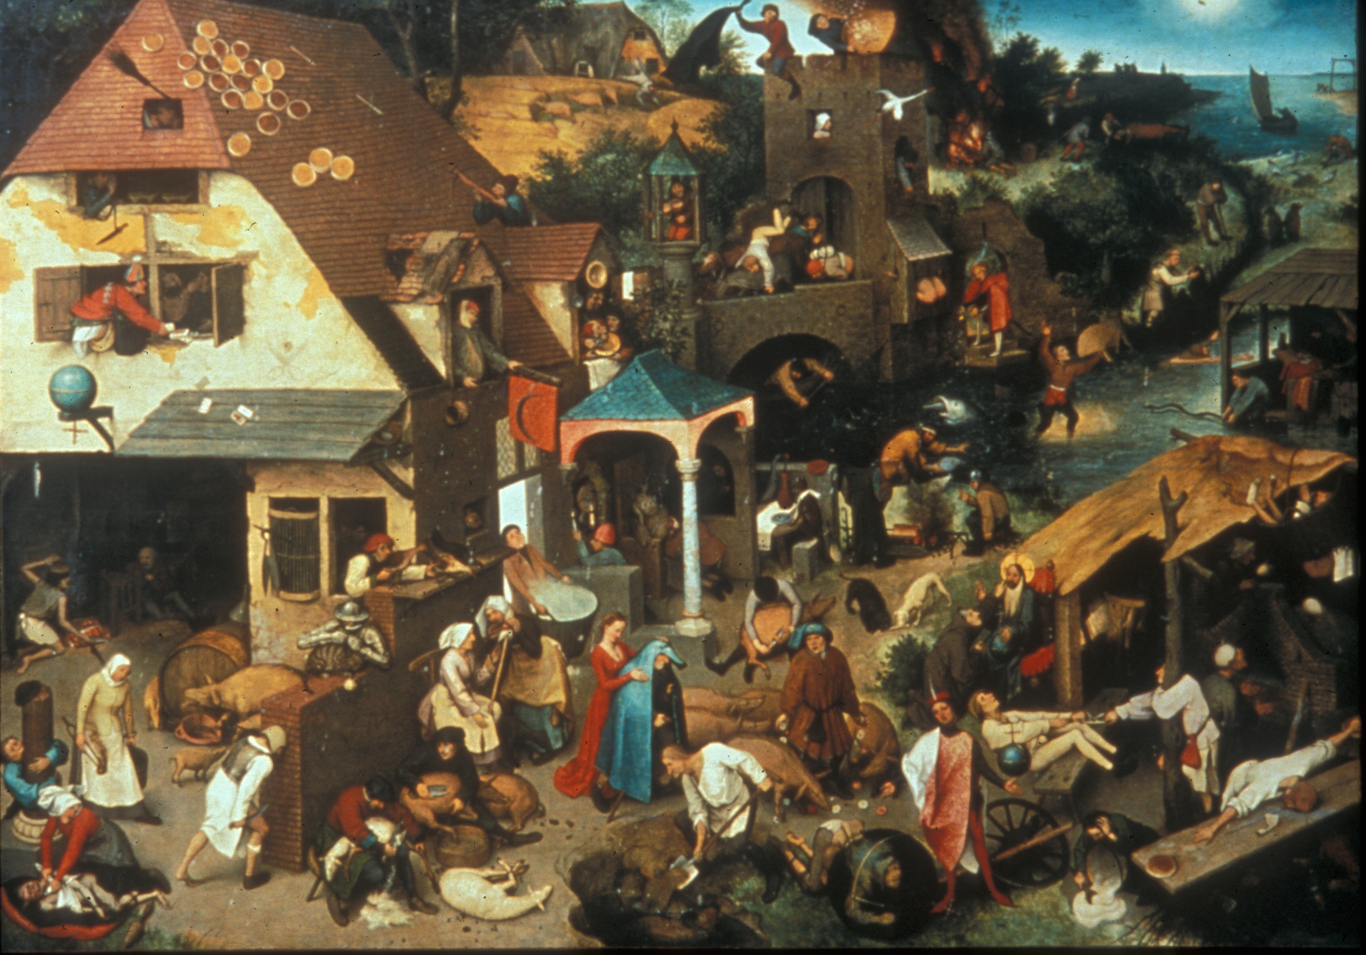

Slide 18
Pieter Bruegel the Elder
Peasant Dance
1567
Oil on wood
Approx. 3ft.9in x 5 gt. 5 in
Kunsthistorisches Museum
Vienna

Slide 19
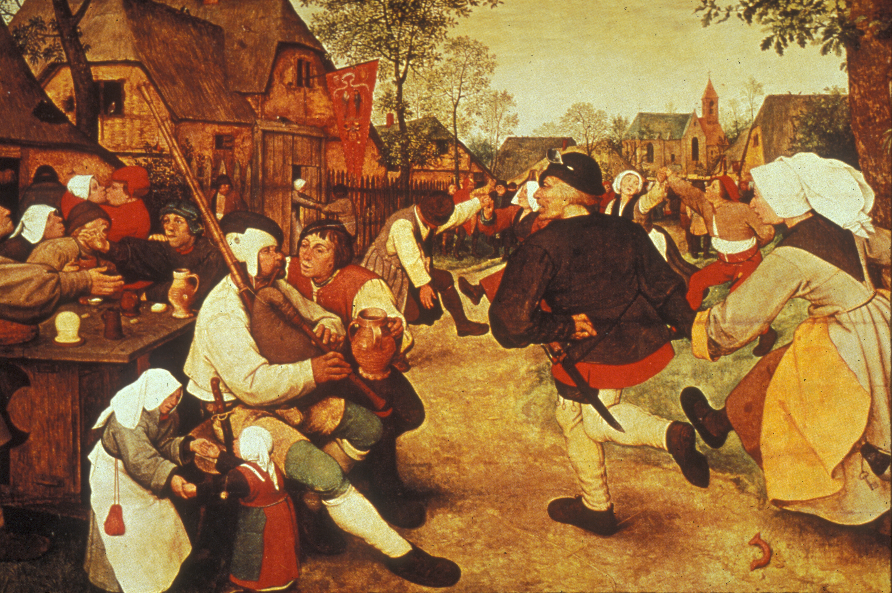

Slide 20
Albrecht Durer (1471-1528)(German)
First to use printmaking as a major medium
First Renaissance man of the North
First to be fascinated with his own image
Combined realism with Italian Renaissance style
Published treatises on perspective and ideal proportion

Slide 21
Notes:
BBC. 1 hour mostly Durer

Slide 22
Albrecht Durer
Self –Portrait
1498
Oil on panel
20 ½ x 16 in.
Museo del Prado
Madrid
P. 639 description

Slide 23
Notes:
Durer ,Self Portrait

Slide 24
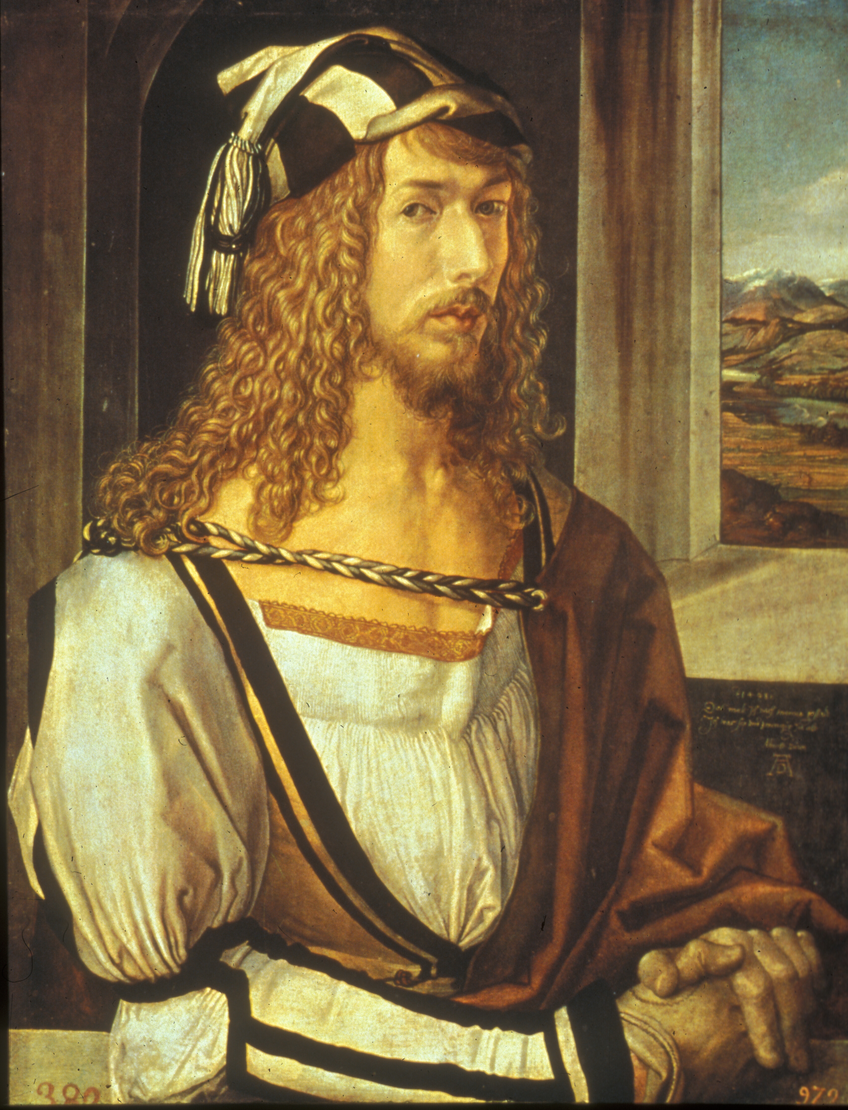

Slide 25
Albrecht Durer
Four Horsemen or the Apocalypse
1497 – 1498
Woodcut
152/5 x 11 in.
Metropolitan Museum of Art
New York

Slide 26
Notes:
Durer’s wood cuts , 5 minutes

Slide 27
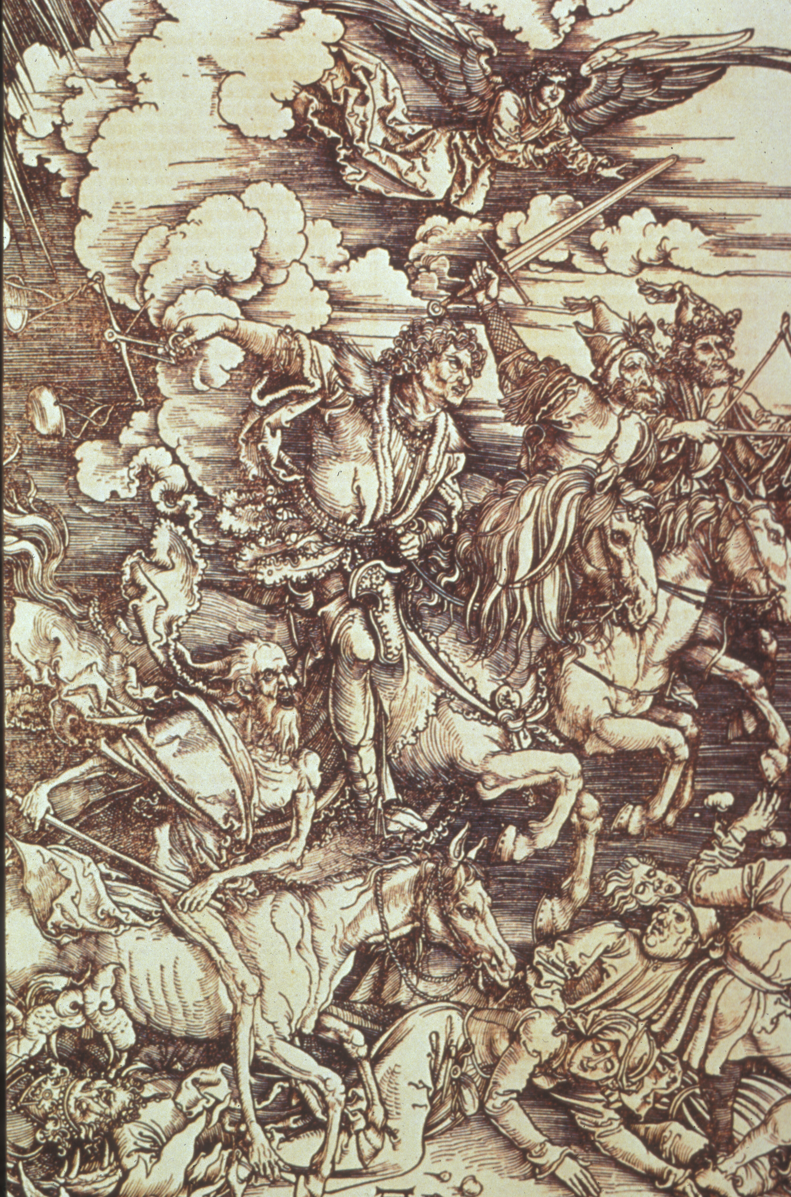

Slide 28
Matthias Grunewald (1480-1528) (German)
Looked back to medieval German mysticism and emotionalism
Best known for the Isenheim Altarpiece
Monumental carved & painted polyptych
Thought to have healing properties when viewed
Best known for the wings painted to protect the carved image of St. Anthony

Slide 29
Matthias Grunewald
Annunciation,Virgin and Child with Angels, and Resurrection
The Isenheim Altarpiece
1510-1516
Oil on Panel

Slide 30
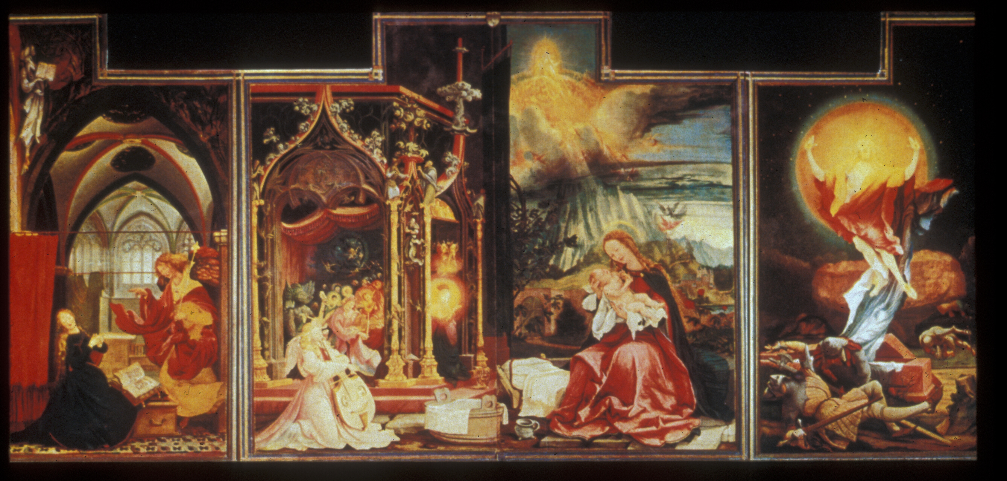

Slide 31
Lucas Cranach the Elder (1472 –1553) (German)
Admirer of Martin Luther
Mythological paintings
Best known for his portraits
Delicate and decorative

Slide 32
Notes:
The Cranachs 42 minutes

Slide 33
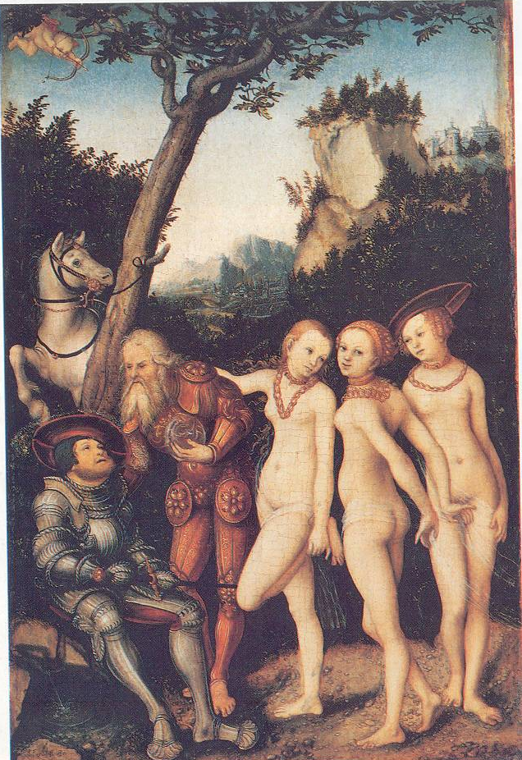

Slide 34
Martin Luther
1533
By Lucas Cranach the elder

Slide 35
Hans Holbein the Younger (1497-1543) (German)
Draftsmanship set the standard for portraits in England
Court painter to Henry VIII
Fused the German skill with lines and precise realism to balanced composition, chiaroscuro, sculptural form and perspective of Italy

Slide 36
Notes:
Hobein 5 minutes

Slide 37
Hans Holbein the Younger
Henry VIII
1540
Oil on panel
343/4 x 29 ½ in
Galleria Nazionale d’Arte Antica
Rome

Slide 38
The End

