Slide 1
Chapter 16 Slide Review
Northern Renaissance

Slide 2
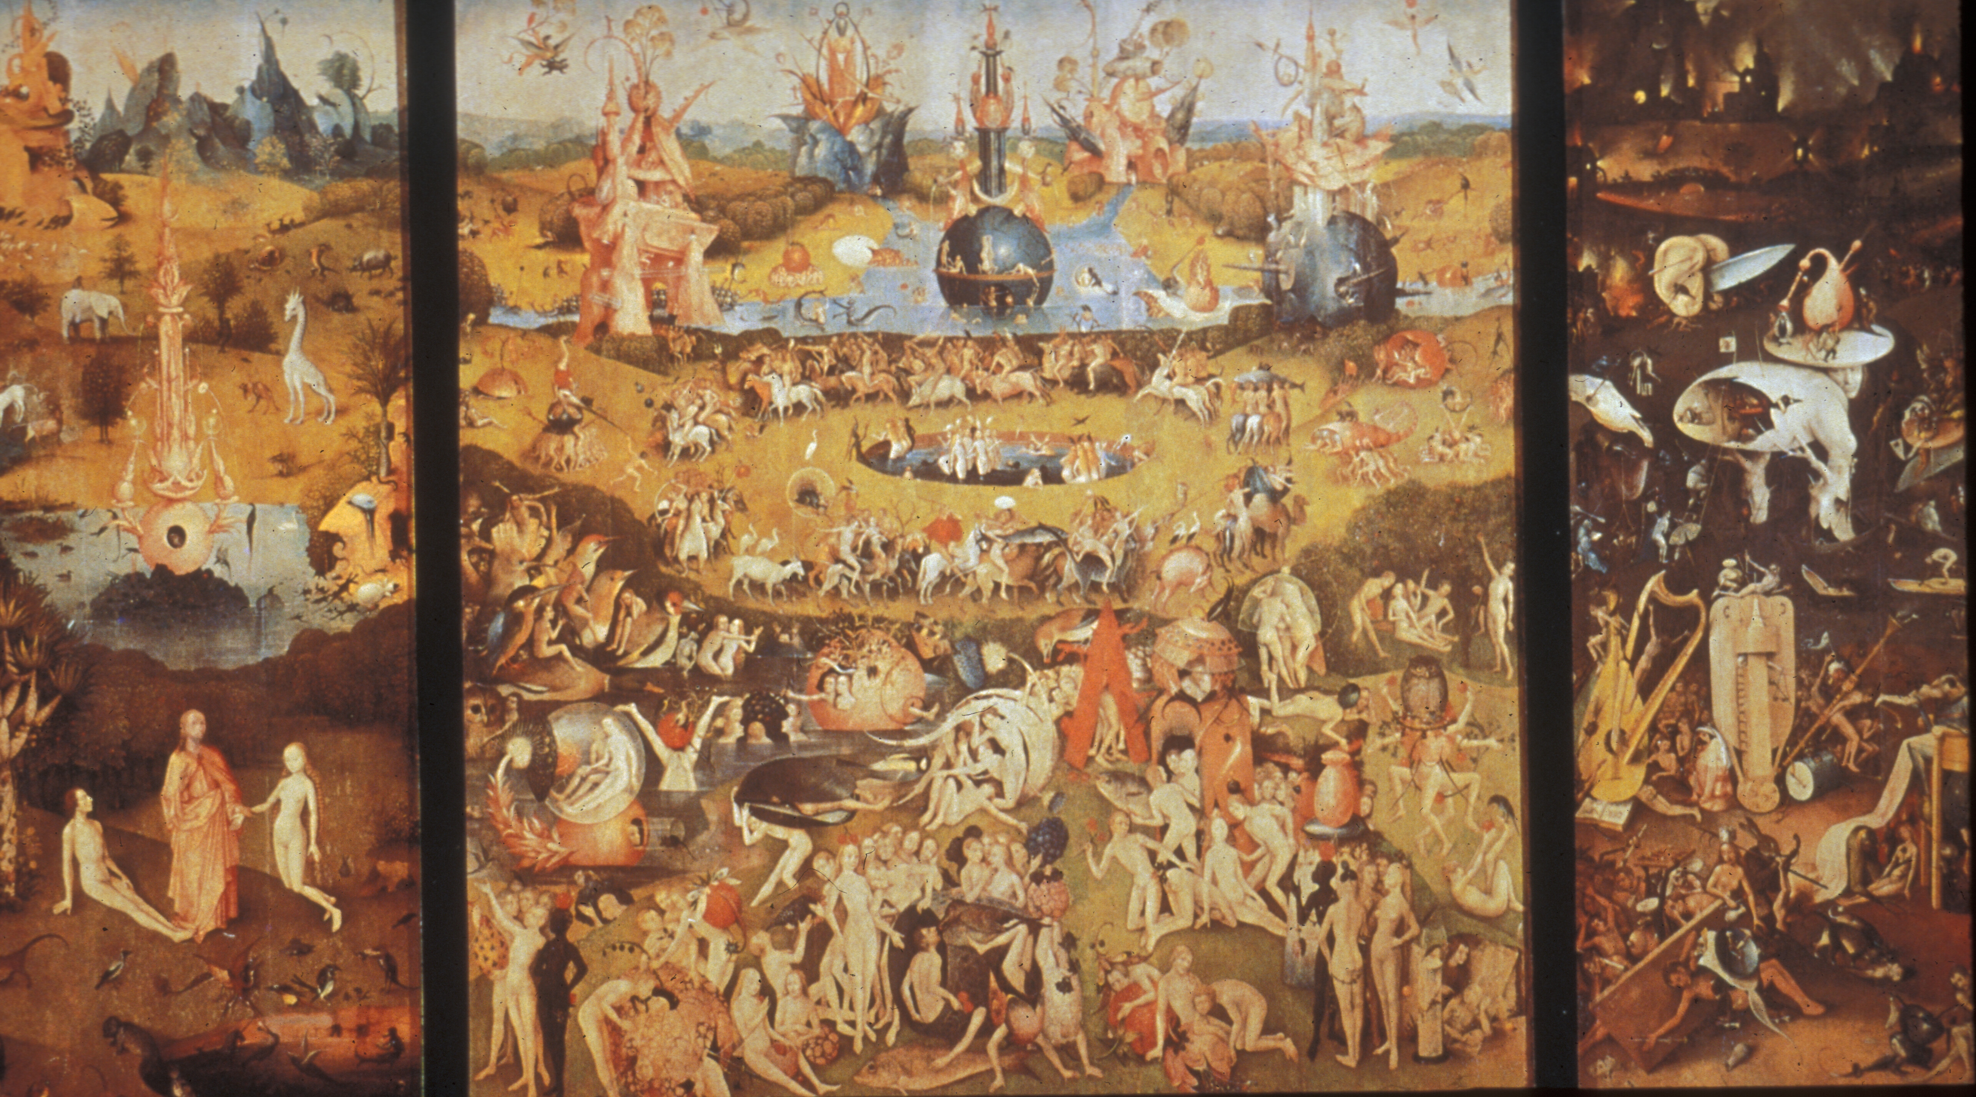
Hieronymus Bosch, Garden of Earthly Delights

Slide 3
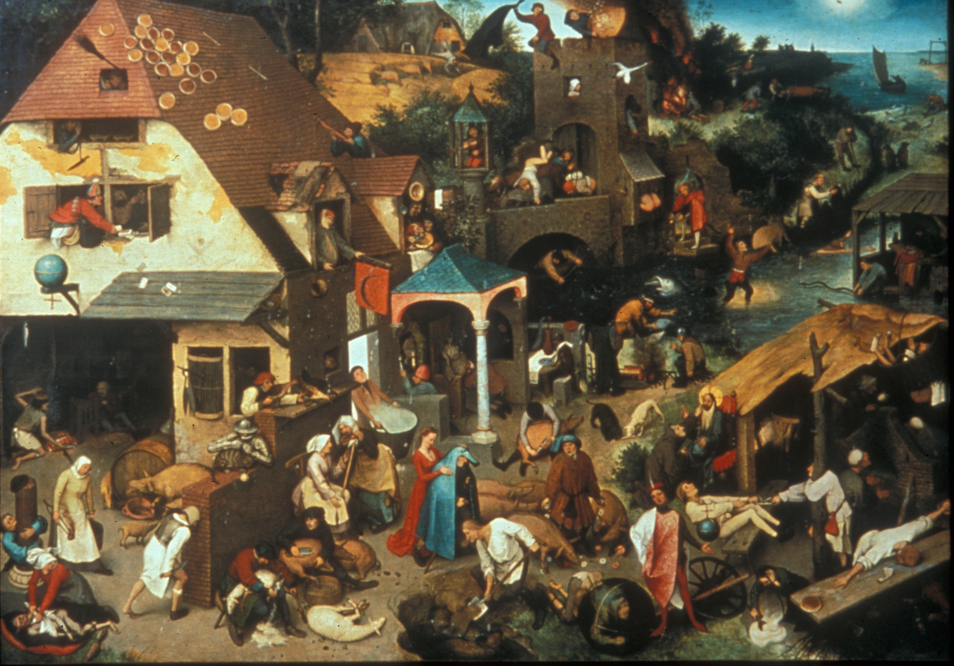
Pieter Bruegel the Elder , Dutch Proverbs

Slide 4
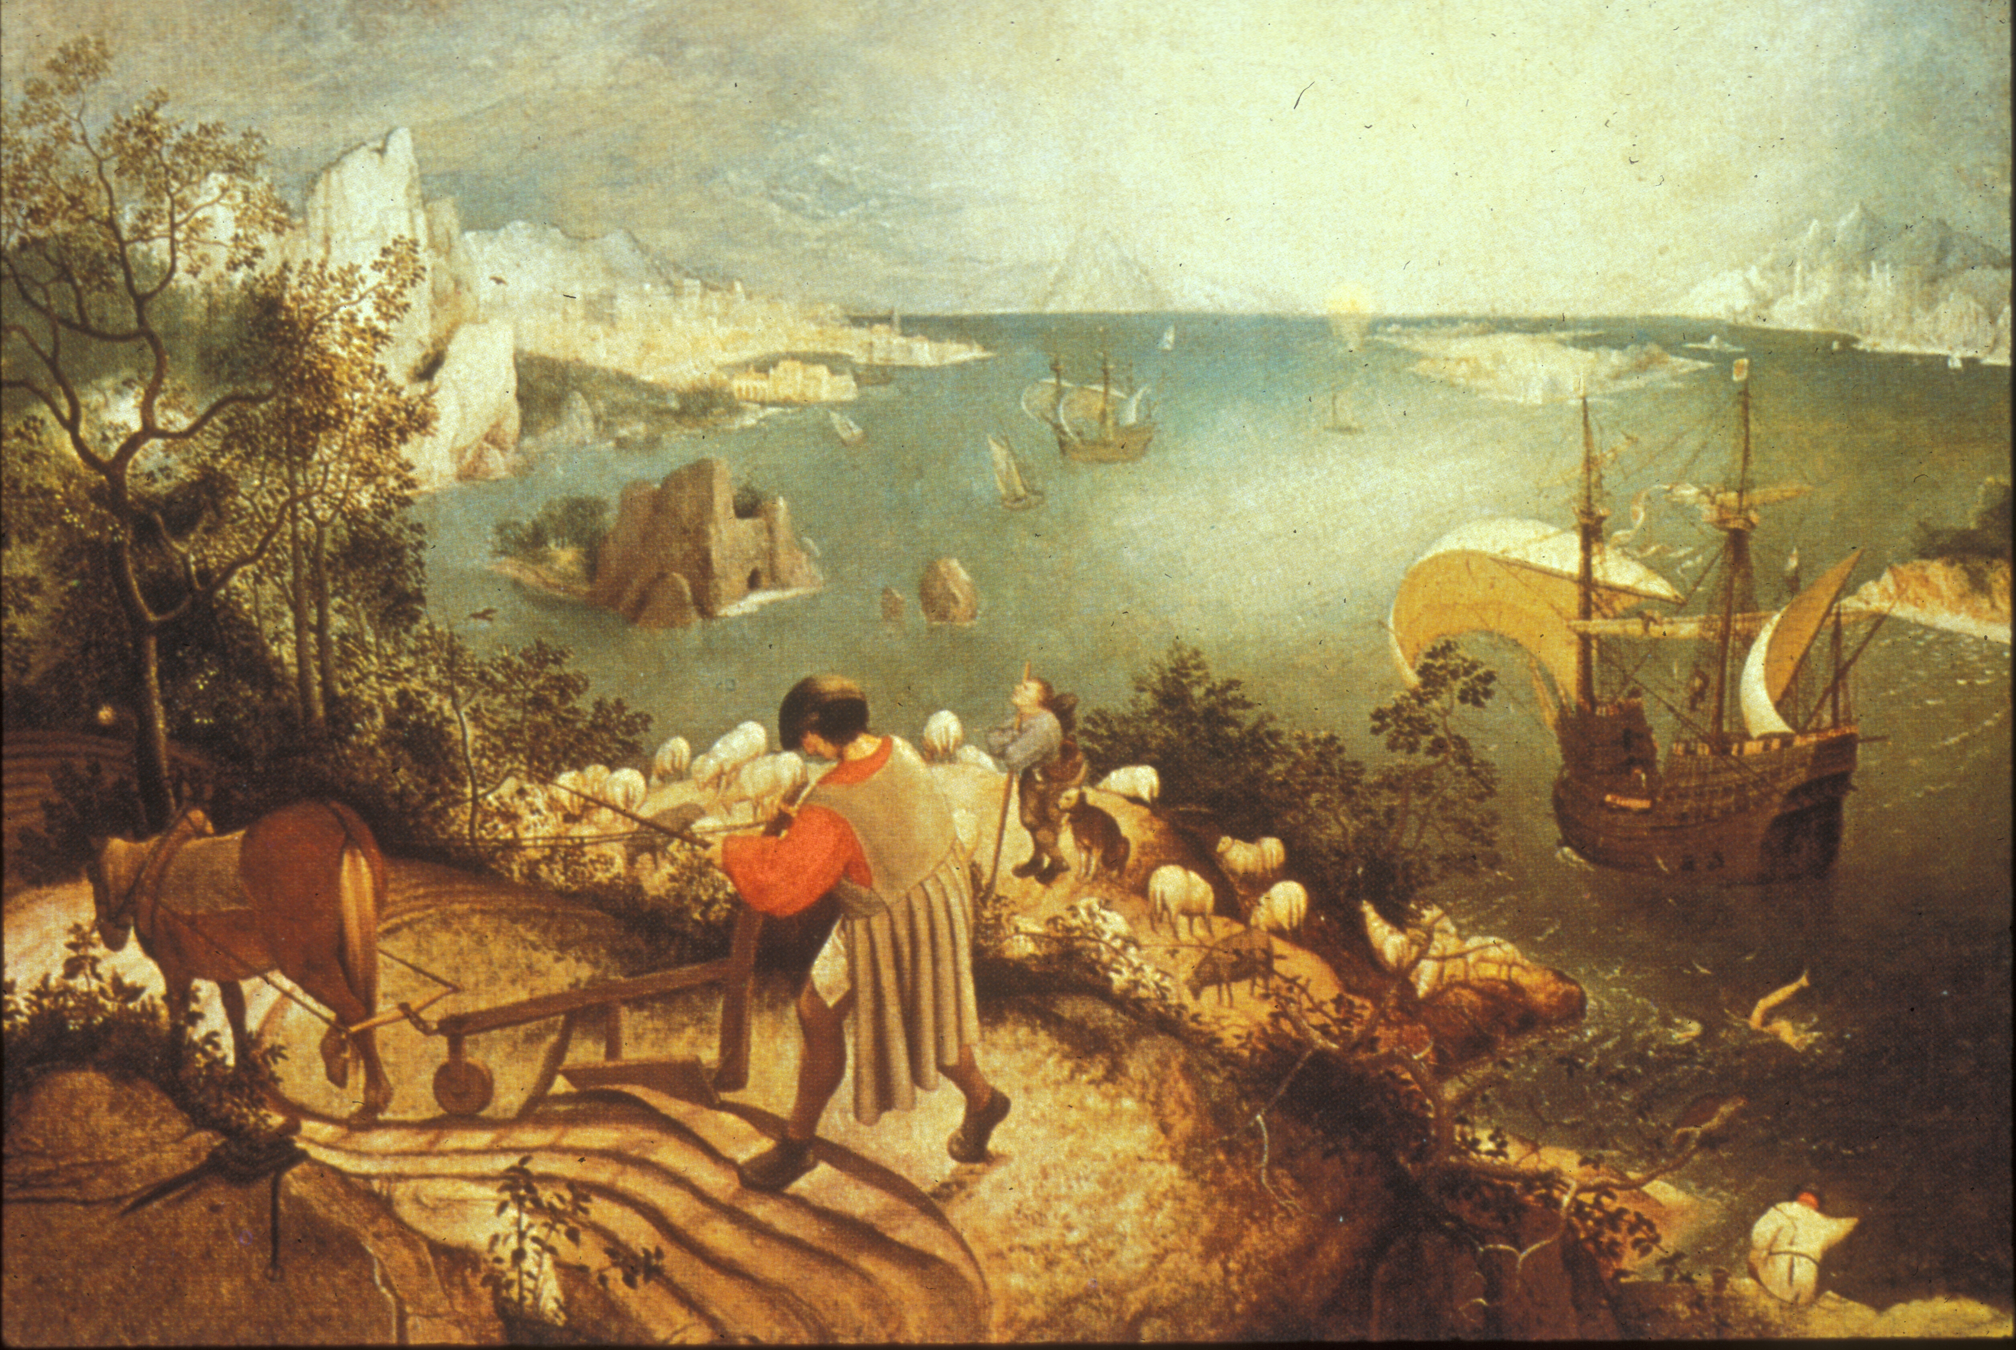
Pieter Bruegel the Elder, The Fall of Icarus

Slide 5
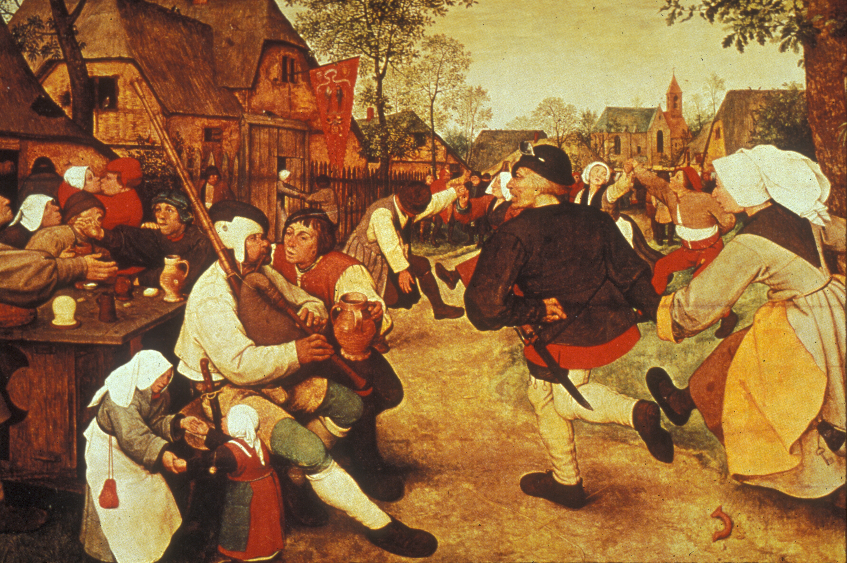
Pieter Bruegel the Elder, Peasant Dance

Slide 6
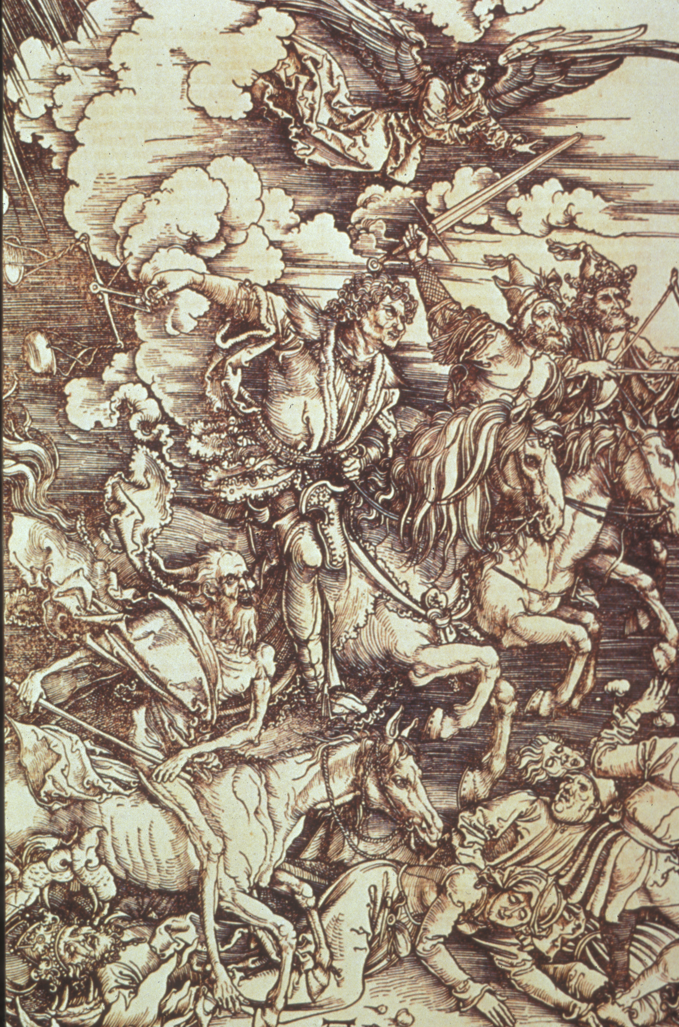
Albrecht Durer, The Four Horsemen of the Apocolis

Slide 7
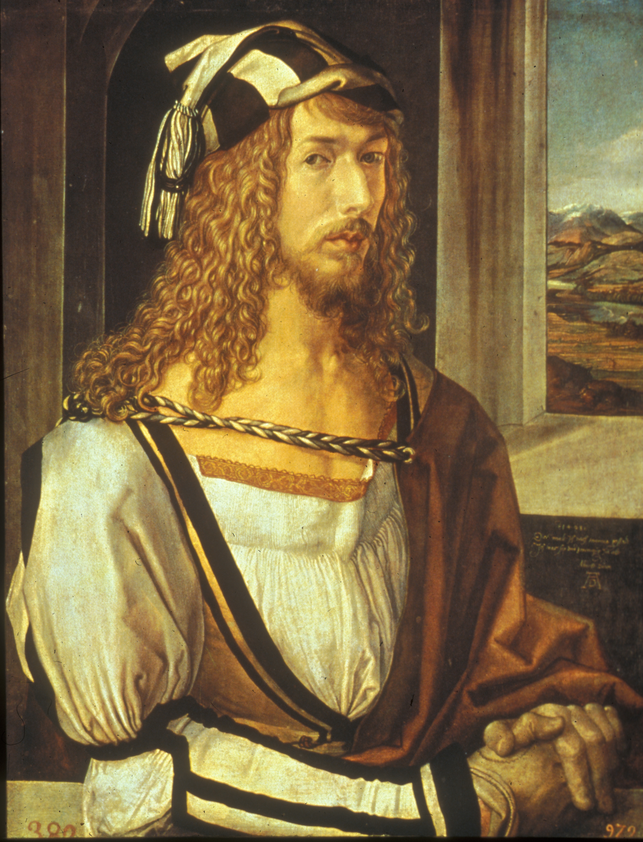
Albrecht Durer, Self Portrait

Slide 8
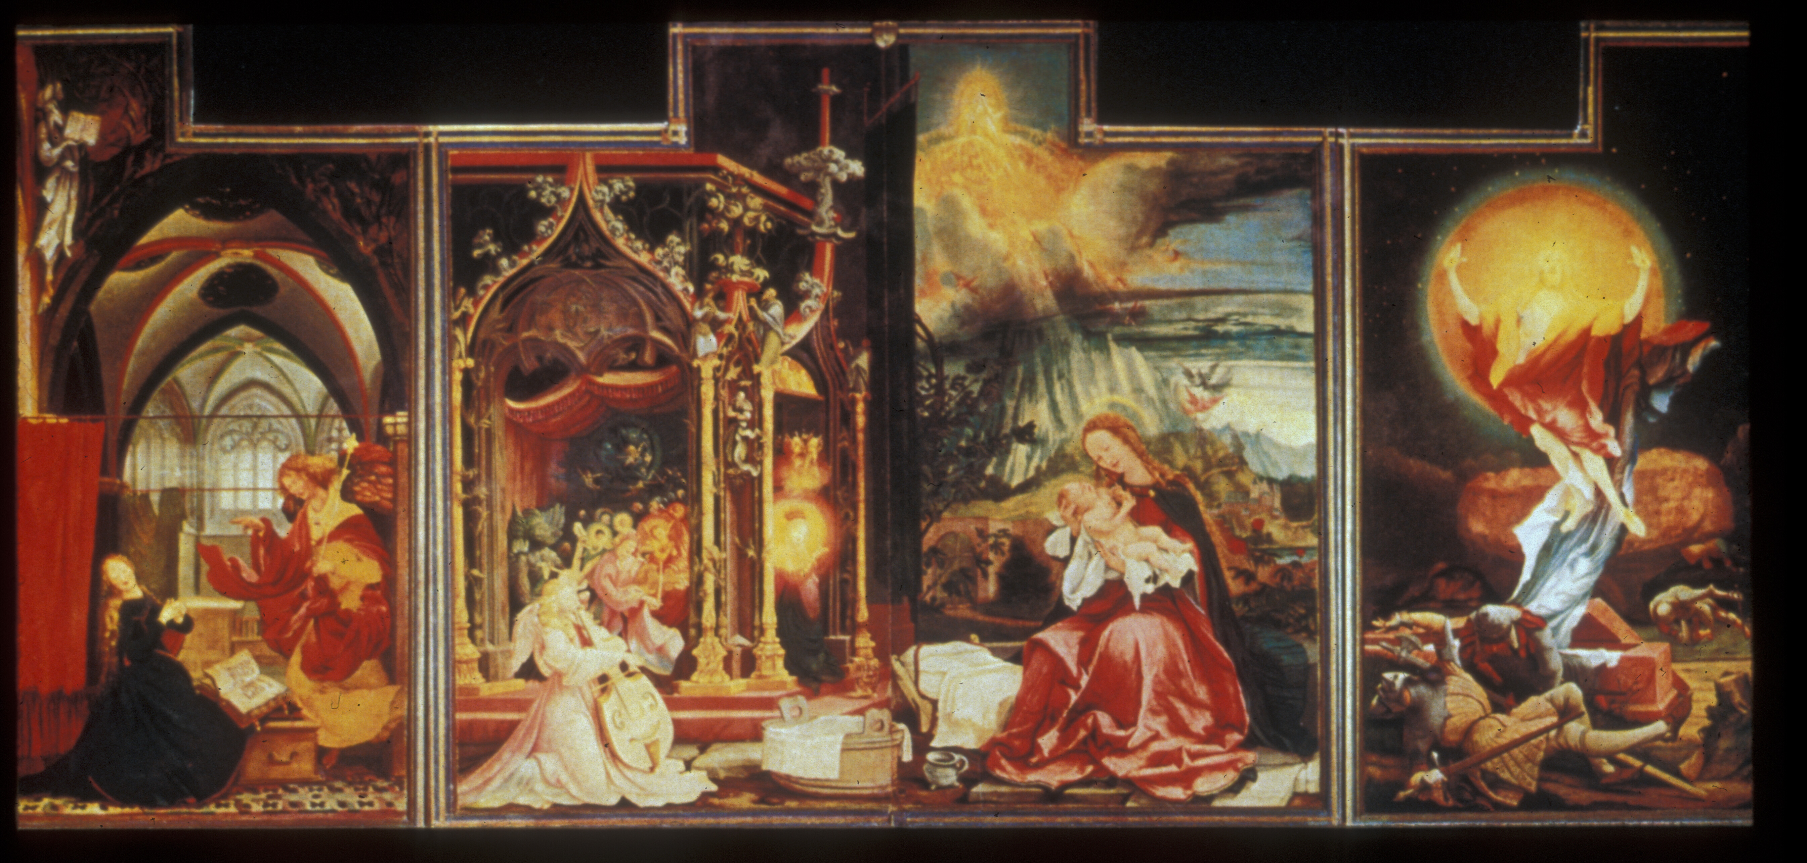
Mathis Grunewald, The Issenhiem Altarpiece

Slide 9
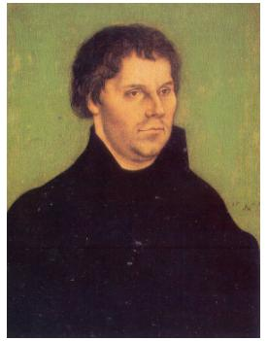
Portrait of Martin
Luther
By Lucas Cranach the
Elder

Slide 10
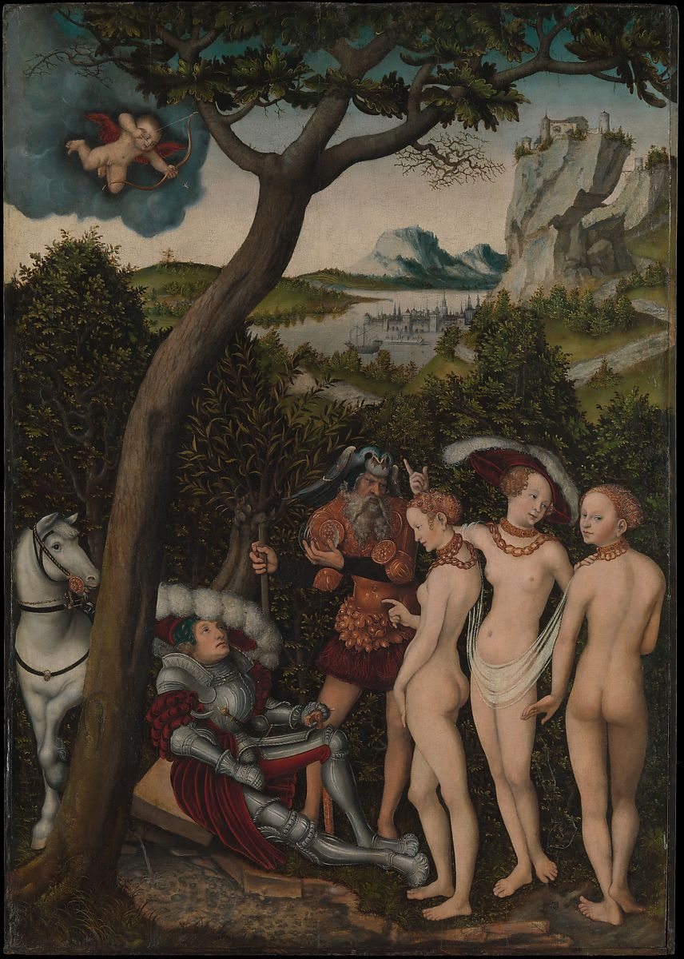
Judgement of Paris
Lucas Cranach
The Elder

Slide 11
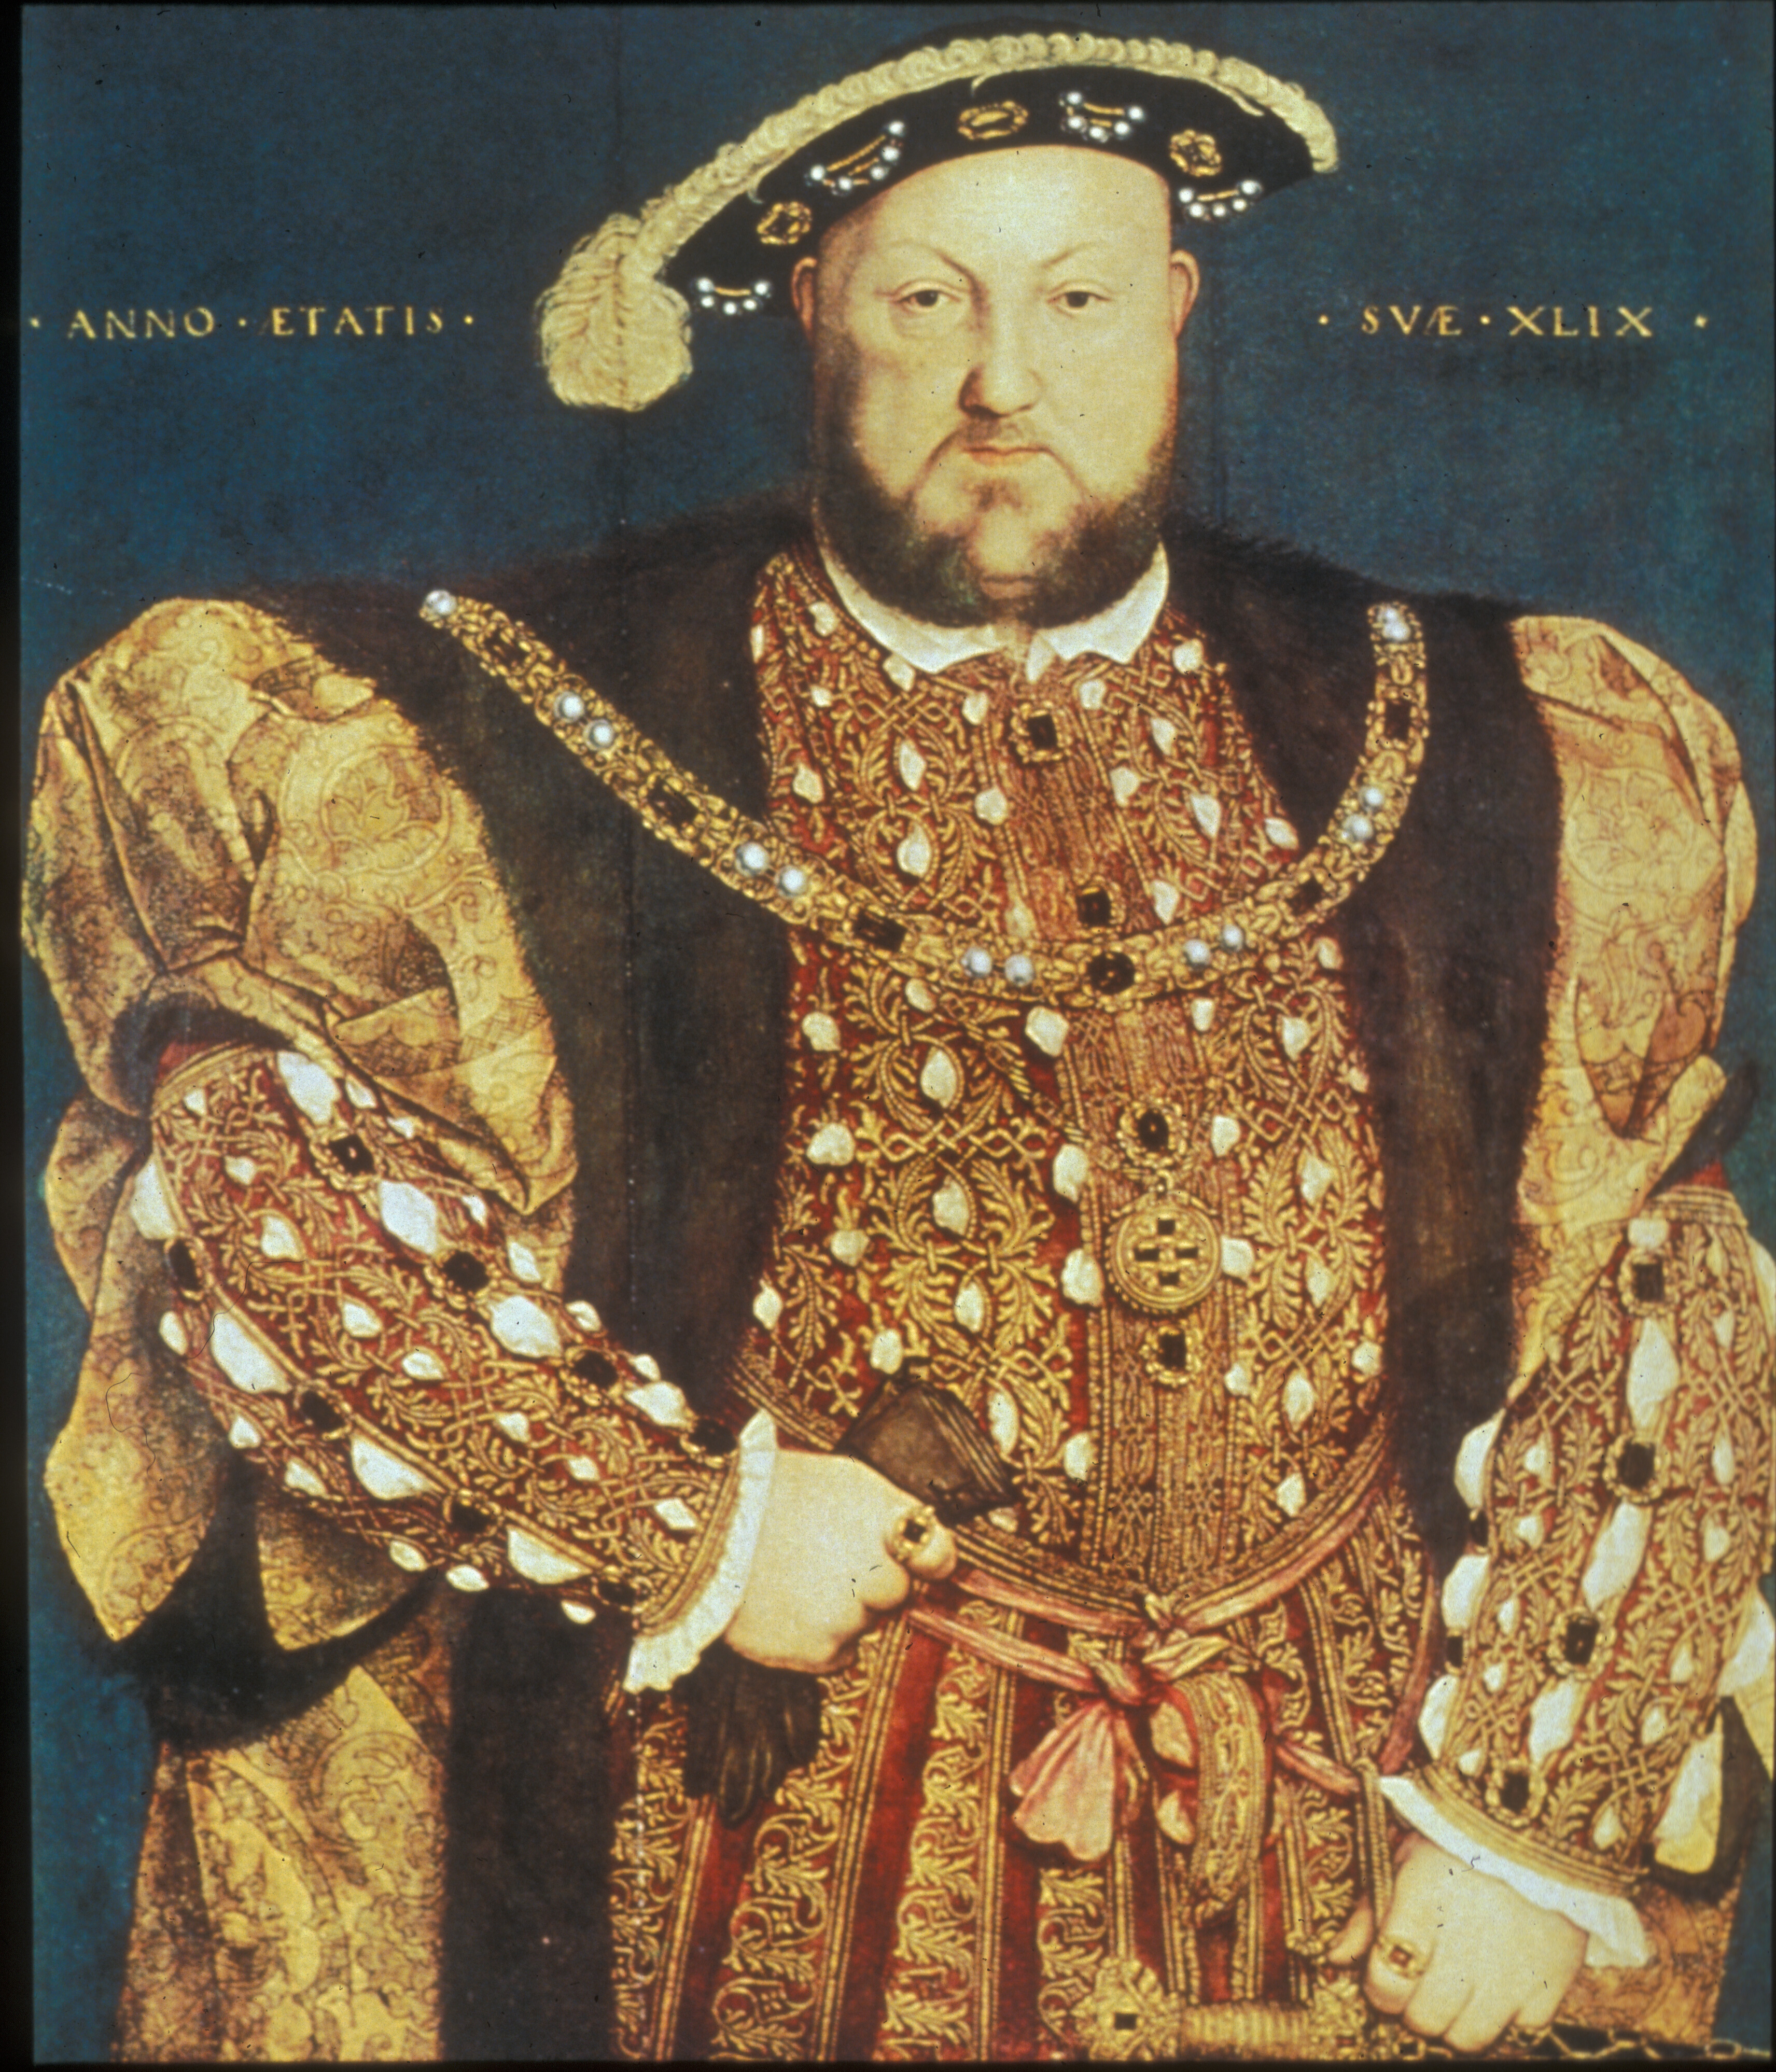
Hans Holbein
Portrait of Henry IX

